Slide 1


|Proof Of Concept
COGNITIVE AUTOMATION FOR
CLIMATE SMART & SUSTAINABLE FARMING
Team Captain: Shivam Gohri
Team: UIET Chandigarh_intelliJ

Slide 2

|BUSINESS CASE
Introduction
Implementation
Business Model

Slide 3

INTRODUCTION
One of the most essential sectors in global economy, Agricultural Industry is facing immense pressure due to various challenges like:
-Rising global population rates -Changing dietary demands -Resource constraints
-Environmental crisis -Inefficient waste management -Stock hoarding
We aim to build Climate Smart, Sustainable, and Technology Driven Agriculture Systems using Cognitive Computing, Machine learning models and IOT devices which will handle the agricultural procedures and will predict best actions.
This will be based on:
-Past experience results -Ongoing conditions of the field -Weather forecast
Our solution encompasses essential issues such as Fair trade, Food traceability, Strategic optimization resulting in the betterment at global as well as individual level. Among numerous advantages, the major ones are:
-Increased yield -Enhanced farm income -Crop shielding
-Stable economy -Prioritized use of resources

Slide 4

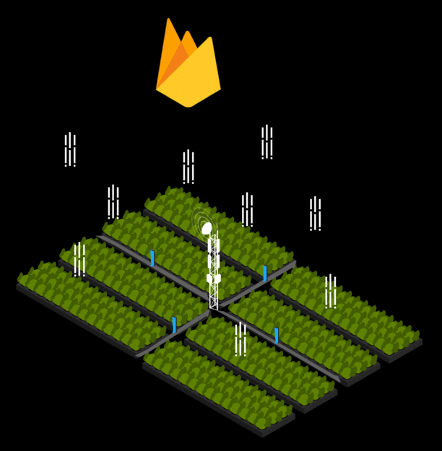
IMPLEMENTATION
Clustering of Sensor Data
Image Data Analysis
Sensor Data Weightage
Records and Display
Clustering of Sensor data : IOT device are placed covering all the field, forming a mesh network. Now, all of the sensor data gathered is partially filtered to avoid nan values (not-a-number) to avoid disfiguring of data-sets. Filtered data is grouped with the device location and is then pushed to the database.
Sensor Data Weightage : Individual sensor data will have some predefined weightage for every derived feature of prediction model from the image data.
This means that for computation of the predictions, all the input sensor data to the ML and AI models will have some importance predefined individually which will be considered while formulating result.
Central Device
Nozzles for Weed elimination using See and Spray Technology

Slide 5

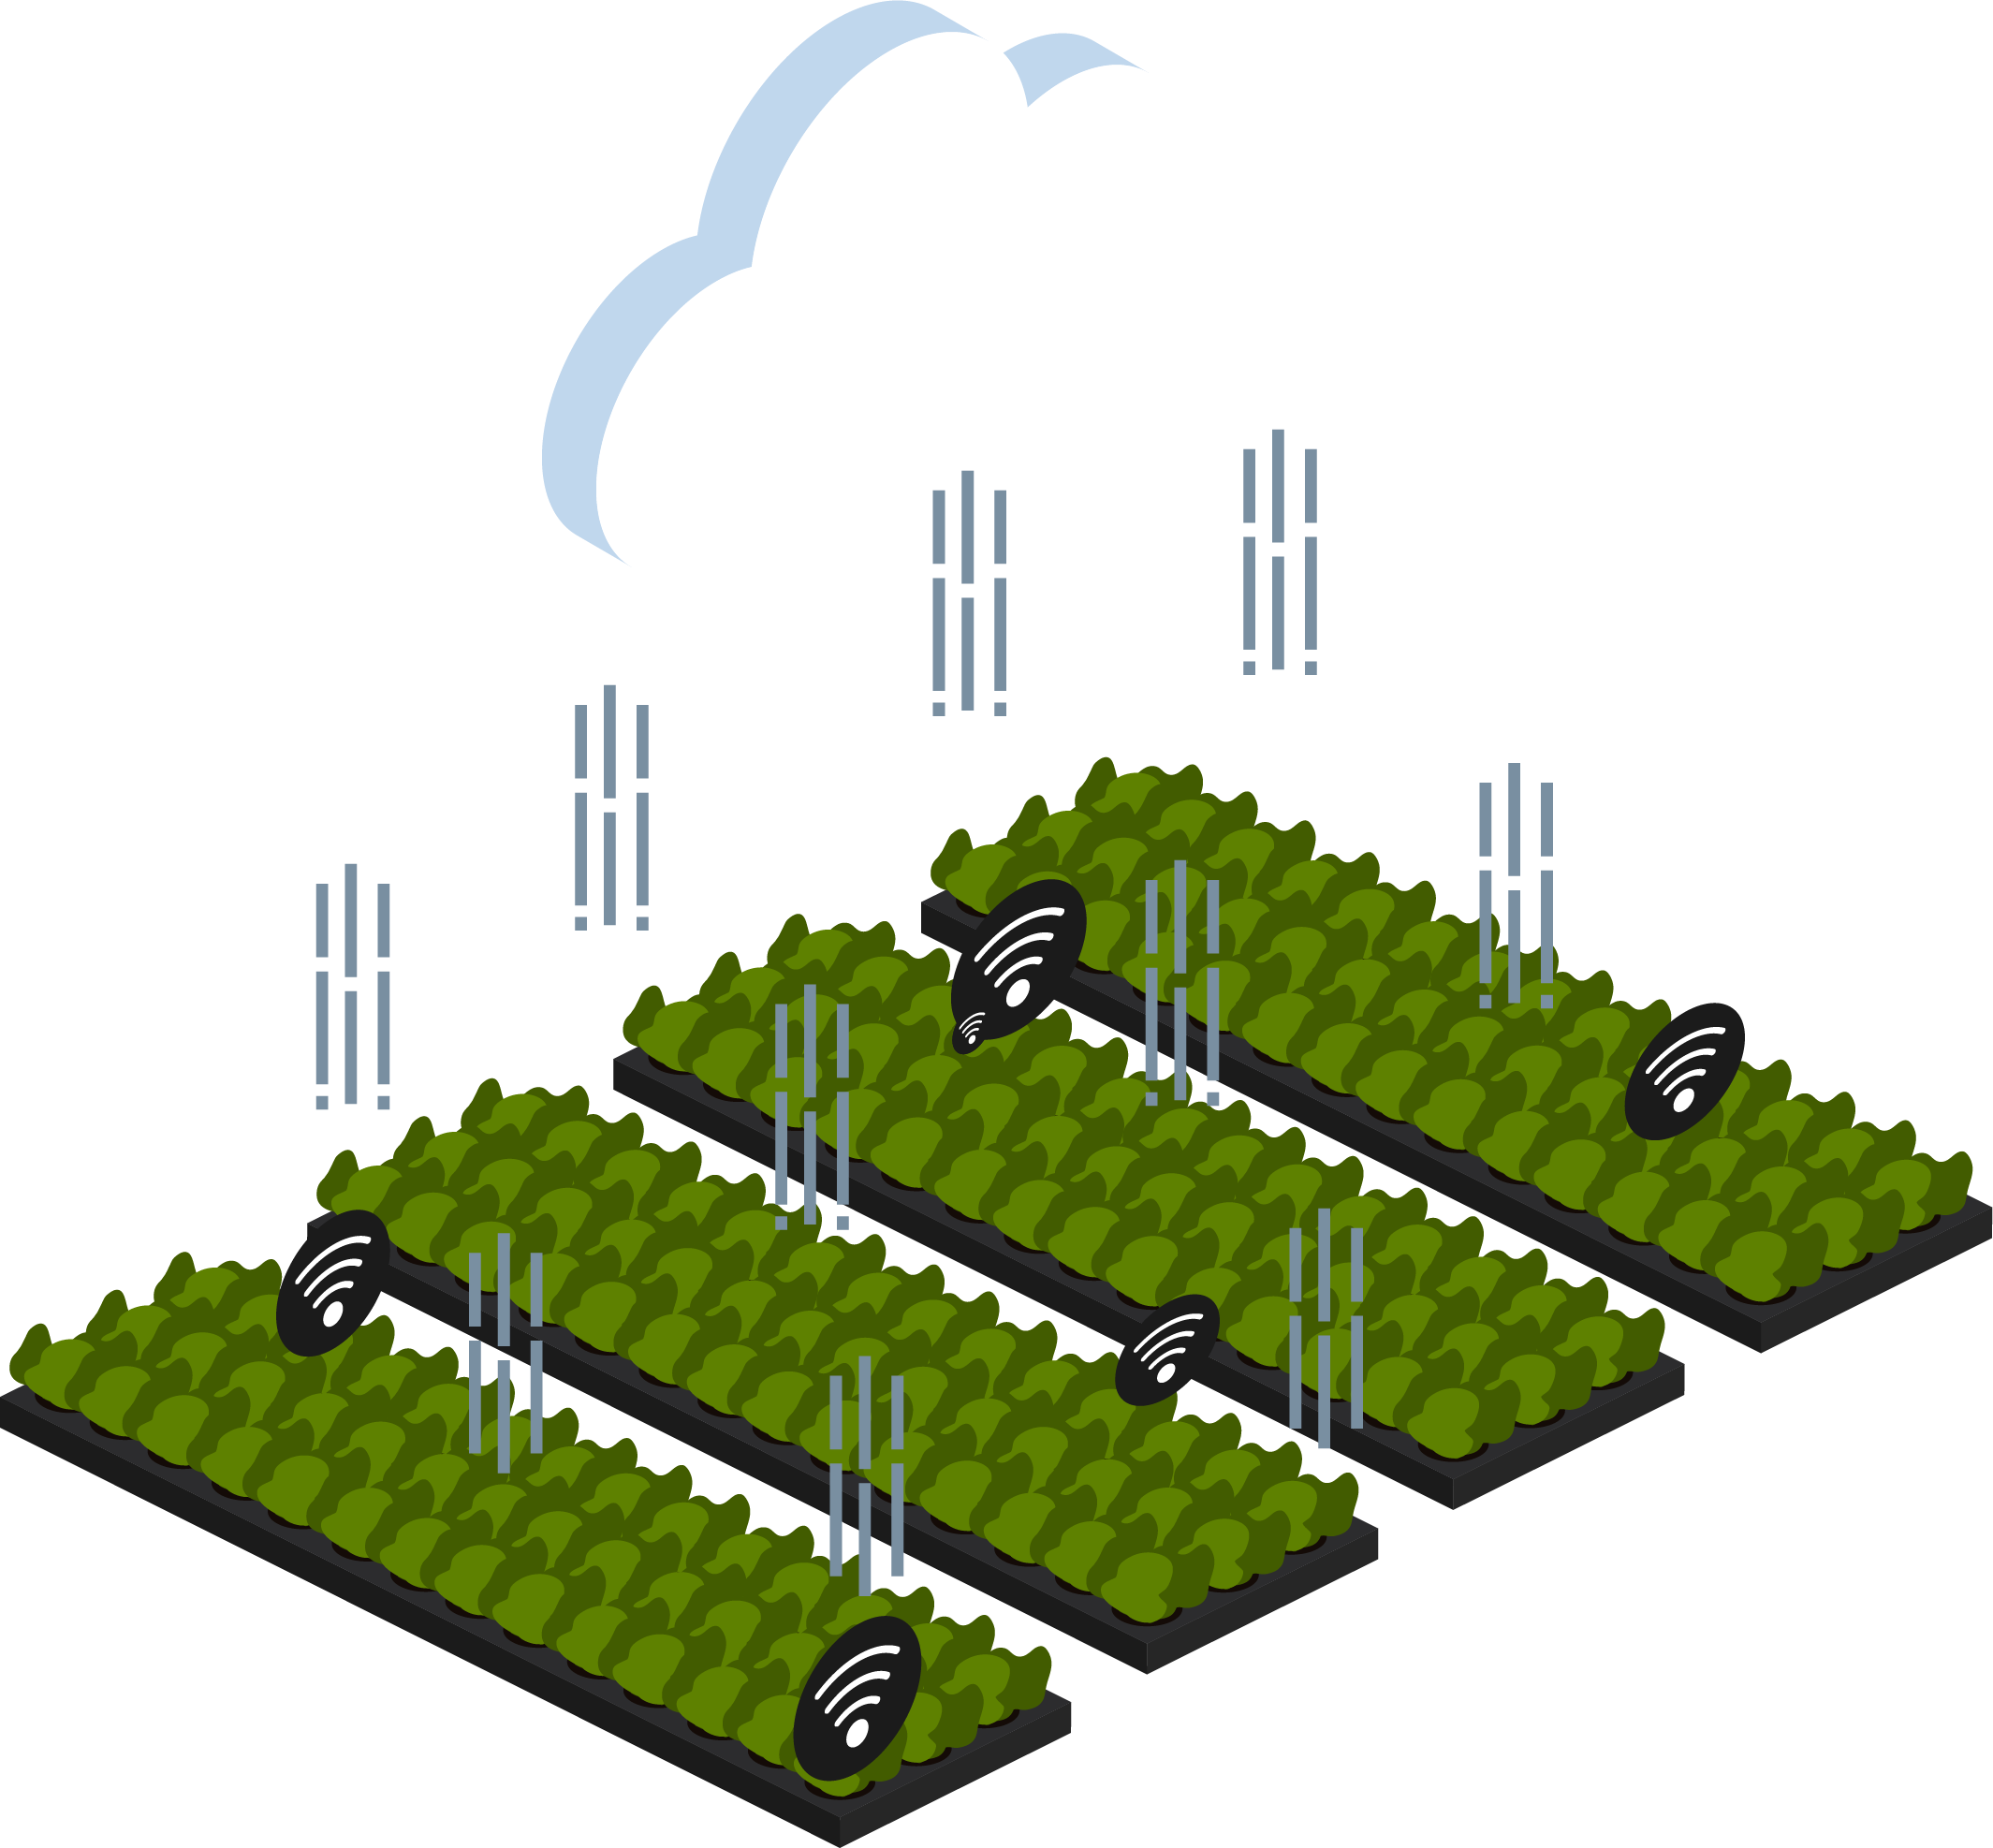
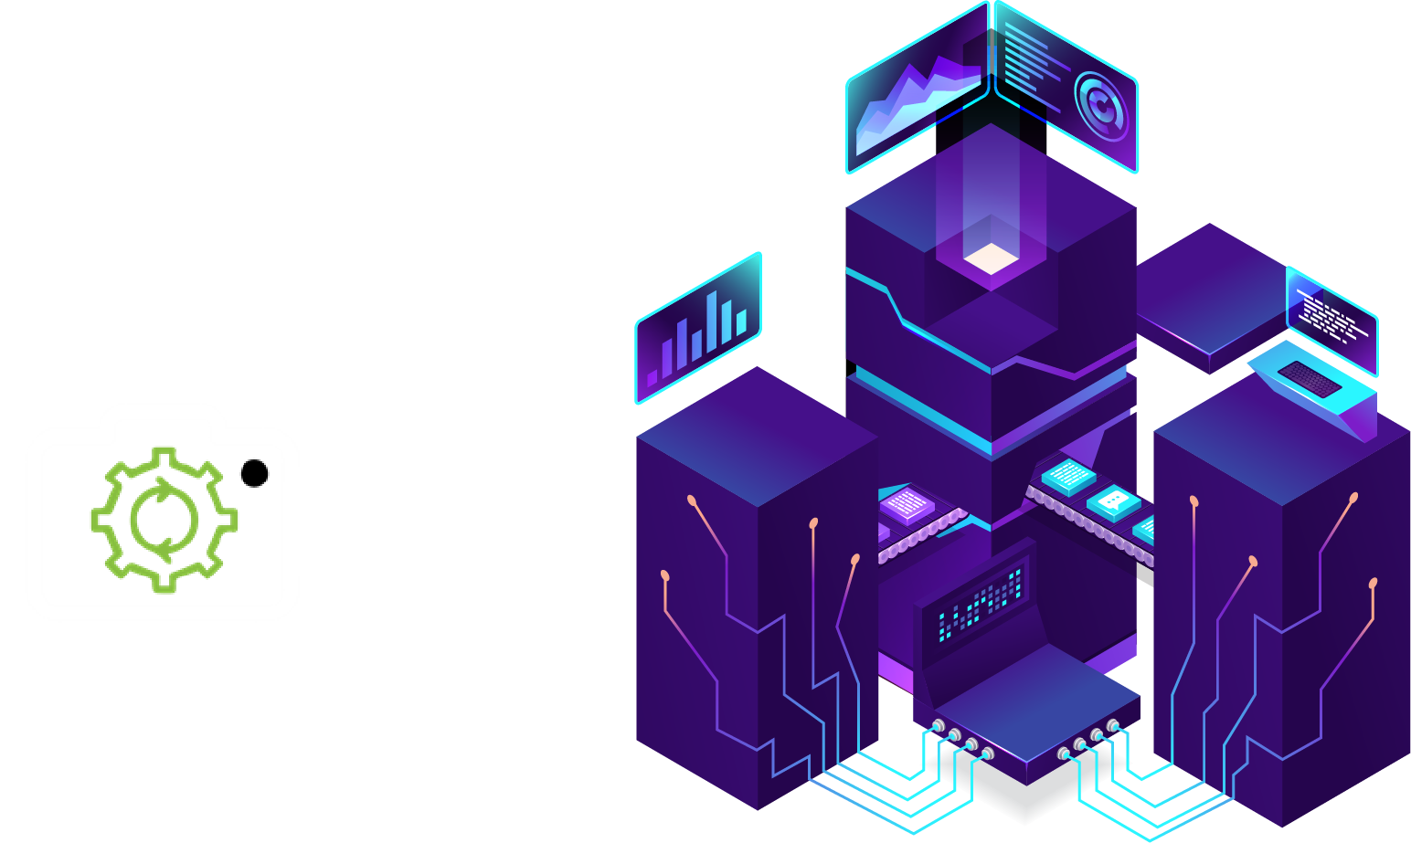
Image Data Analysis : Idea here is to compute locally and push resultant meaningful data to the database server. Image gathered from the on-field devices is firstly fed to the Main Processing Unit which comprises of our Machine Learning models and previously maintained data-sets, that are also being trained on current group sensor data.
The output predictions are saved to the database and also the result is analysed to proceed with the preferred on-field robotic processes such
as timely irrigation, sprinkling pesticides on the field
areas detected positive for the pest detection,
and performing other daily agricultural
practices and hence efficiently managing the
field work and enhancing the overall
yield in a sustainable manner.
Soil texture
Yield Prediction
Desirable Crops
Disease Detection
Weeds and Pest control
VIEW:
DATASET
CODES
GUIDEBOOKS
Images from field
Main Processing Unit

Slide 6
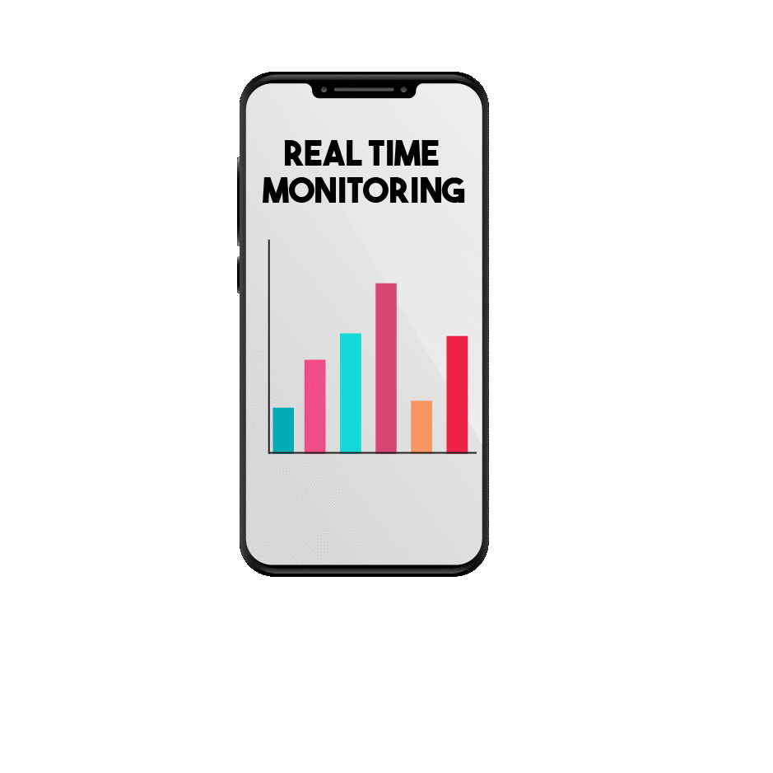
Records & Display : All useful processes happening will be backed up in the Log file which can be used for further analysis. Field-supervisor’s Dashboard will contain all the information about real-time data, alerts if anything goes wrong and requires attention, notifications of all the updates by government agricultural bodies and local businesses.
User will also be enabled to control robotic processes of the field and will be able to remotely monitor its field, saving lots of human labour and power. Weather forecast will also be incorporated with the models and predictions will be sent to supervisor to take the
necessary preventive measures.
FEATURES
Alerts
Field Control
CLICK TO GET
APPLICATION APK:
APPLICATION
Real Time Monitoring
Periodic updates (Soil and Weather)

Slide 7

Business Canvas
Key Partners
Key Activities
Value Proposition
Channels
Customer
Segments
-Microcredit Institutes
-Agricultural resource companies
-Research institutes
-Collaborators for local market
-Farmer cooperatives
-Government
-Yield prediction
-Real time monitoring and alerts to farmers
-Energy Management
-Weed and Pest Management
-Species and Stock Management
Mitigation of risk
(Using Weed and Pest management, Disease detection)
Increase of revenue
(Using Yield enhancement and automation)
Decrease of cost
(Reduction in labour, energy)
Food Security & Transparency
(Through Yield prediction and Centralized database)
-Mouth to mouth publicity
- Government Schemes
-Through innovation
-Advertising
-Website
-Farmers
-Government
-Food regulating bodies
Cost Structure
Revenue Streams
-Device set-up cost
-Agricultural resources cost
- Sale from produce
- Leasing assets when not in use

Slide 8
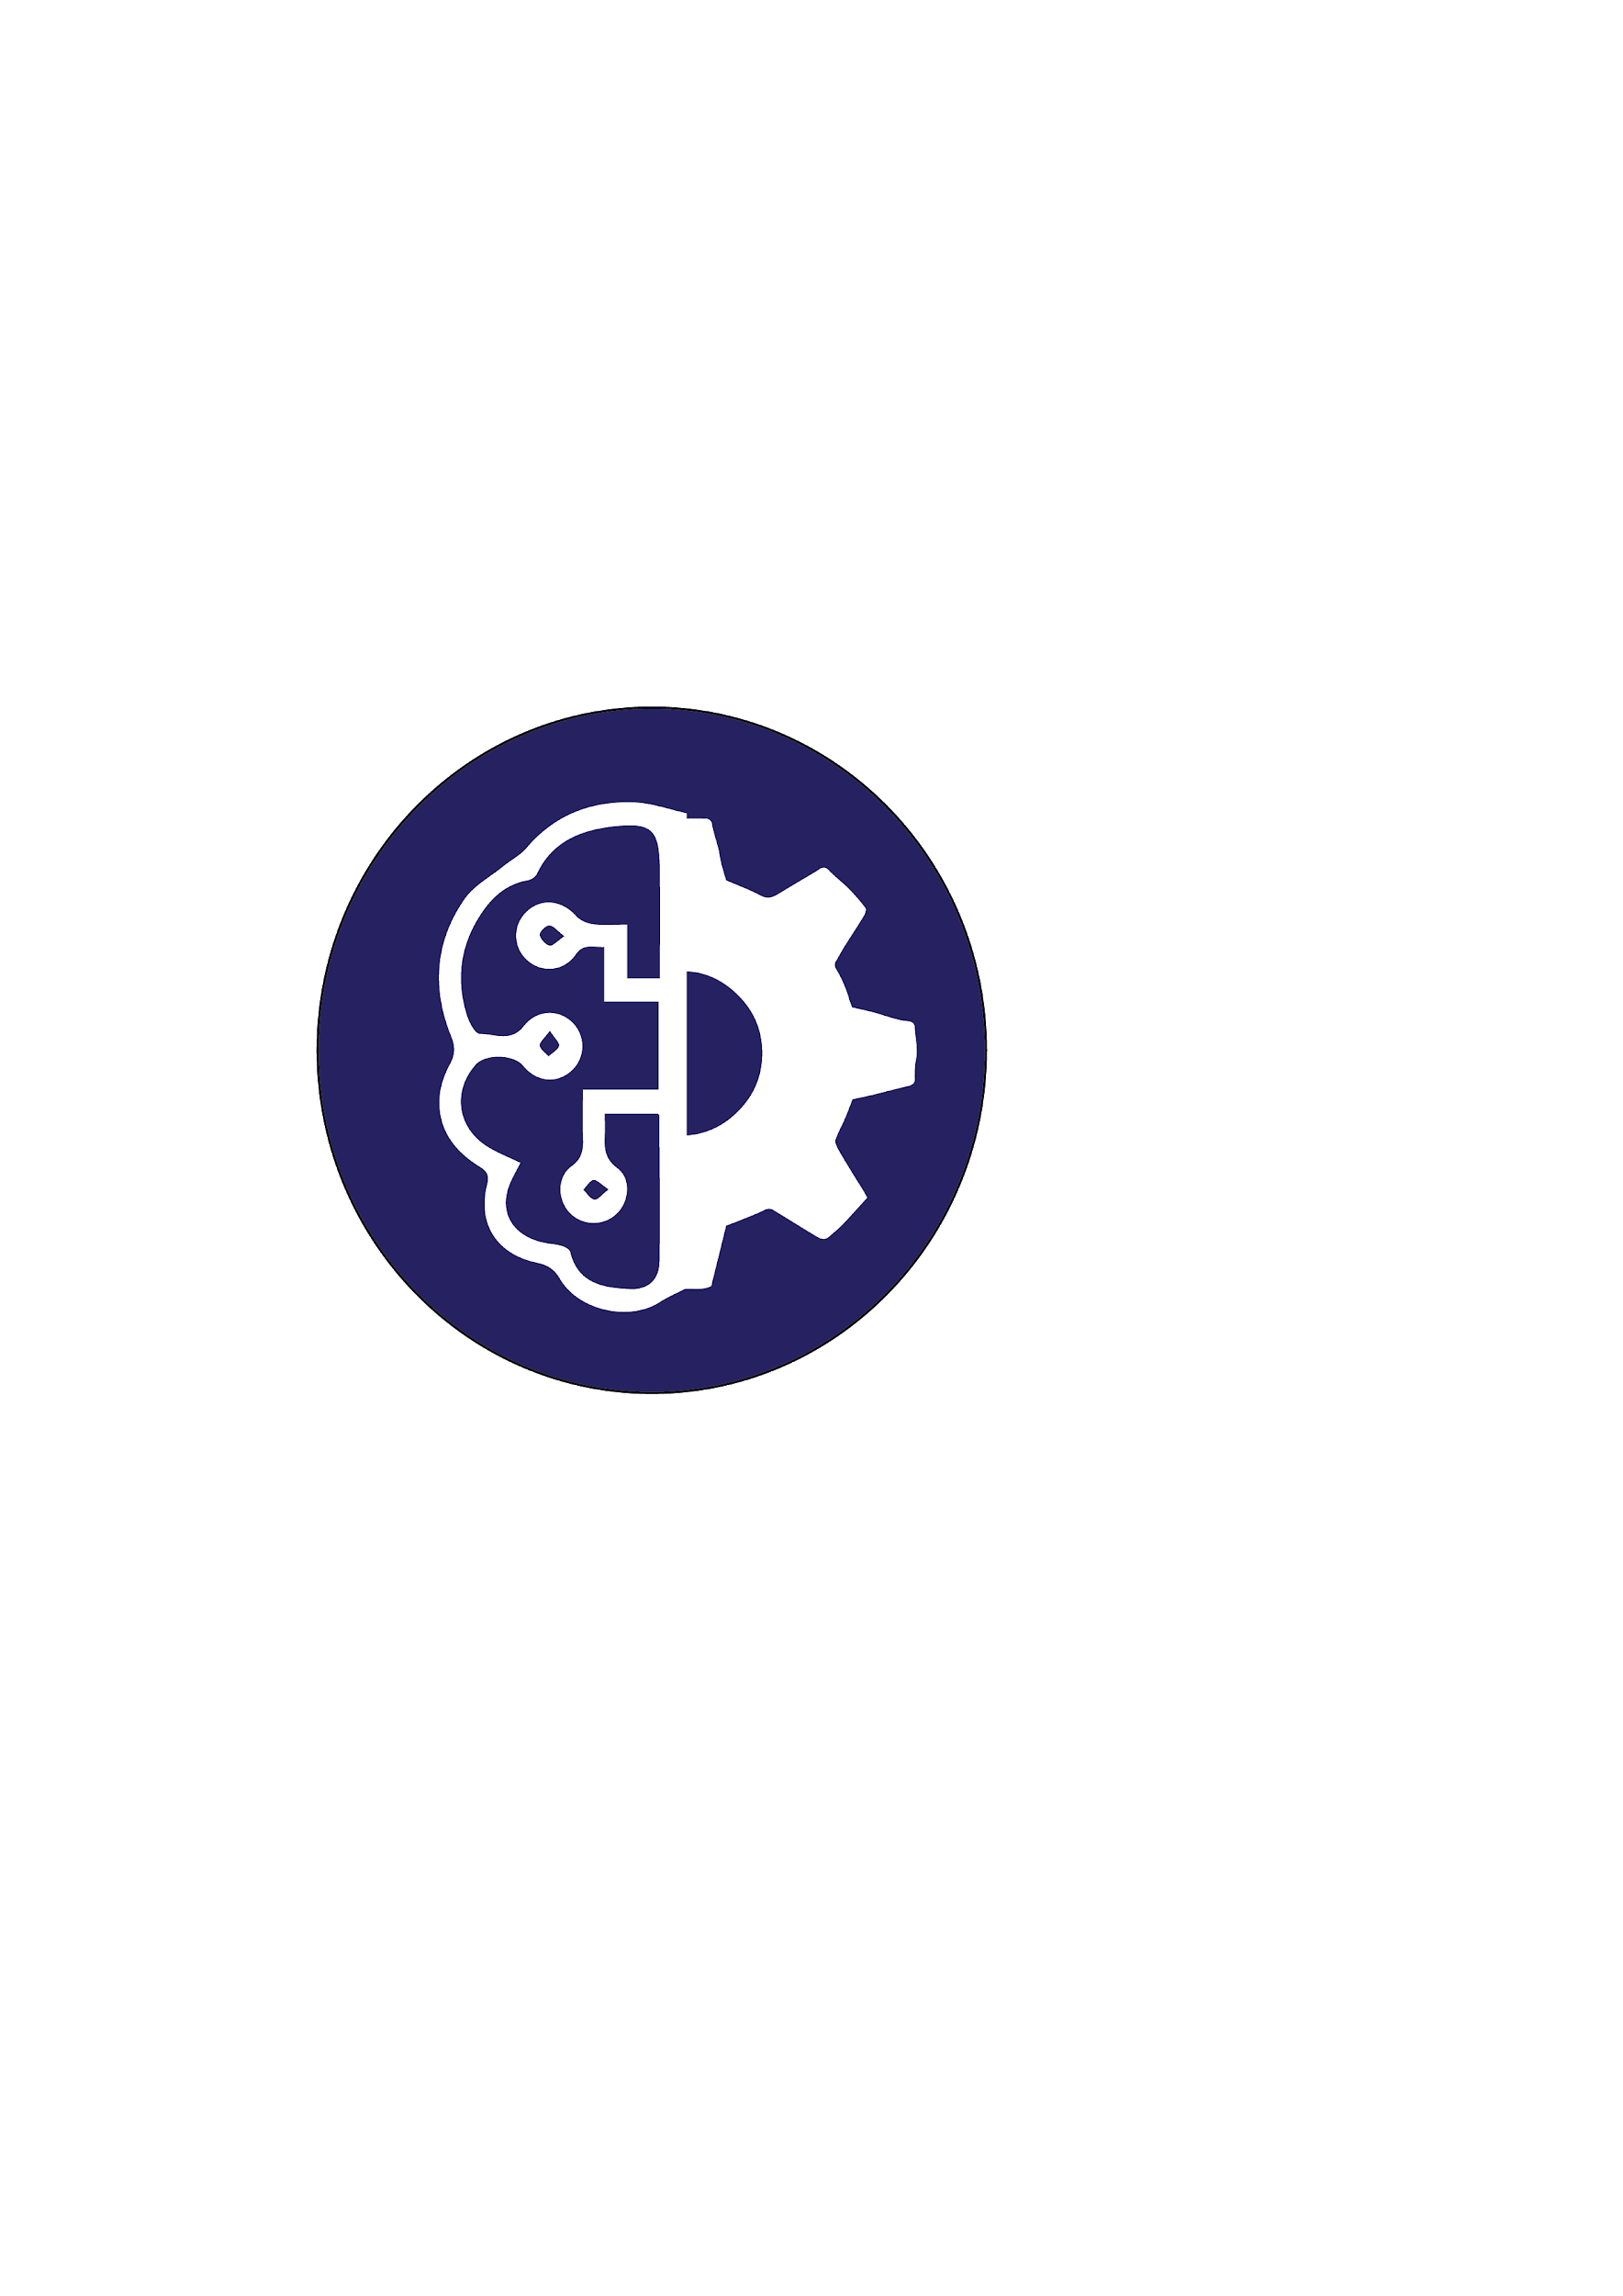




|ARCHITECTURE
Event Operation
Automation
Signals
Different agricultural
processes
ON FIELD
MACHINERY
ML & AI
Models
Data
sets
Event
Analysis
Prediction Results
Live Report Data
DASHBOARD
-Alerts
-Notifications
-Real time Data
MAIN PROCESSING UNIT
DATABASE
Useful
data for
records
Image data
Users
Clustered sensor data
LOG FILE
IOT DEVICE
Event Initiator
Reports

Slide 9

|DESIGN
ROBOTIC PROCESS AUTOMATION
3D printed models for the IoT device containing all the sensors will be implemented on the field forming a mesh network. 3D printed models will be cost-effective and would be very reliable.
IoT device will communicate with the Main Processing Unit and it will further communicate with the agricultural robotic processes leading to the automation in the whole system which will be efficient.
MAIN
PROCESSING
UNIT

Slide 10
|DATA MODEL
Sensor Data
Attributes
SENSOR ID
.pdf
TYPE: FLOAT
-Location
-Weightage
-Crop-dependent
SENSOR DATA
-Temperature
-Humidity
-Soil moisture
-Soil pH
-Air Quality
.xlsx
Derived Features
CLICK TO ACCESS FULL
DRIVE FOLDER:
IntelliJ
(bit.ly/deloitte_intelliJ)
-Soil Texture
-Disease Detection
-Weed & Pest Detection
-Yield Prediction
-Desirable Crop(s)
IMAGE

Slide 11
|DATA MODEL
The data chain consists of a technical layer and a business layer.
The technical layer captures raw data and converts it into information while business layer makes decisions and derives value from provided data services.
We convert the IoTs information to float data type and the analysis on this information data depends on the following attributes:
-Location
-Weightage
-Crop-dependent
The derived features from image dataset are Soil Texture, Disease Detection, Weed & Pest Detection, Yield Prediction, Desirable Crop(s)
Analysis is done on this prepared data. Mostly, patterns in data are identified using Smart Decision Systems (SDS).

Slide 12

|IMPACT
Our system differentiates between crop and weed and precisely deliver a small but lethal dose of weedicide if weed is detected, it reduces the use of chemicals upto 90%.
The dataset consisted of 20,000 images of healthy and unhealthy leaves divided into 16 categories and our algorithm classifies the leaves with 96% accuracy.
Early pest detection reduces yield loss by up to 20-40%.
Sensor based smart irrigation controller systems save upto 30-55% water.
Real time monitoring of farm using IoT enables farmers to increase production rates by 70%.

Slide 13
Thank You

